Slide 1


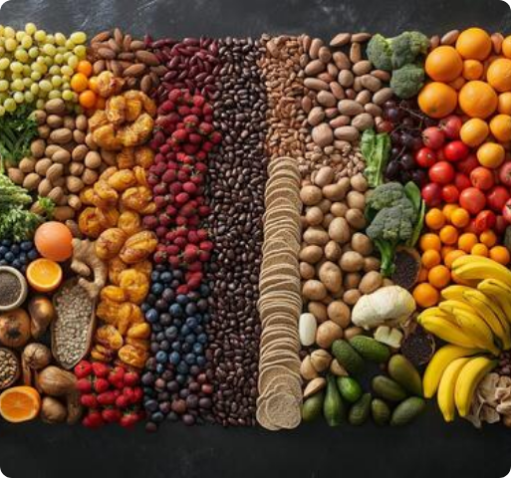
AI-Based Nutritional Assessment System
Deficiency Detection & Personalized Meal Planning — Fuel Your Body Right, Every Single Day 🥦✨
XGBoost & RF ML Models
Lab Report OCR
Persona Meal Plans

Slide 2

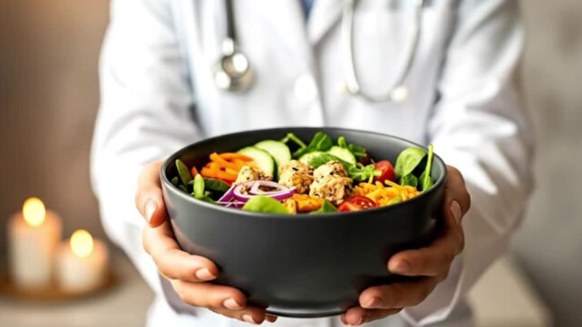

Turning Clinical Data Into Everyday Nutrition
Bridging the Gap Between Pathology Reports & Daily Eating Habits 🥑
The Problem We Solve
Hidden Deficiencies: Vitamin B12, Iron, D3 & Calcium go unnoticed, causing chronic fatigue.
Idle Pathology Reports: Lab PDFs stay sitting in drawers instead of shaping weekly groceries.
Generic Diets Fail: One-size-fits-all advice ignores your blood biomarkers & food choices.
The NutriAI Solution
Machine Learning Diagnostics: XGBoost models accurately score deficiency risks from symptoms.
OCR Pathology Parser: Automatically extracts blood biomarkers from uploaded PDF test reports.
Persona Meal Planning: Converts risk scores into 7-day personalized plans & shopping lists.
Pathology to Plate Integration
OCR Clinical Extraction & ML Analytics Pipeline

Slide 3







Plates Built Just for You — Turn Deficiency into Delights
Targeting Detected Micronutrient Risks with Precise, Wholesome Meal Plans 🥑🍛
Iron & Hemoglobin Risk
Vitamin D3 & Calcium Risk
Symptoms: Chronic fatigue, pale skin, cold hands & brittle nails
Symptoms: Joint stiffness, backache, muscle weakness & slow recovery
Target Foods & Meals Provided:
Target Foods & Meals Provided:
Palak Dal, Beetroot-Amla Juice, Sprouted Moong Salad, Jaggery Chikki paired with Vitamin C for max absorption.
Ragi Dosa, Fortified Curd, Paneer Tikka, Sesame Seed Laddus, and Sun-Dried Mushroom Curry.
Vitamin B12 & Folate Risk
Magnesium & Potassium Risk
Symptoms: Brain fog, tingling in hands/feet, memory dips & low mood
Symptoms: Night leg cramps, restless sleep & muscle spasms
Target Foods & Meals Provided:
Target Foods & Meals Provided:
Fermented Idli/Dosa Batter, Egg/Paneer Bhurji, Fortified Milk Smoothies & Rajma Spinach Bowls.
Pumpkin & Flax Seed Granola, Fresh Coconut Water, Banana Oats Smoothie & Avocado Bowls.
Persona Auto-Filtering:
1-Click Grocery List Export

Slide 4








Everything NutriAI Delivers
A unified healthcare platform bridging clinical pathology with daily food choices
XGBoost & RF Diagnostics
Blood Report Fusion
Persona Meal Plans
6 tuned XGBoost models predicting B12, Iron, D3, Calcium, Folate & Zinc deficiencies.
OCR extraction engine parsing lab report PDFs & photos into digital biomarker inputs.
Tailored 7-day meal plans for Veg, Non-Veg, Vegan, and Eggetarian dietary preferences.
Barcode & Food Scanner
3.0L Water & Macro Tracker
Gamification & Streaks
Camera-based barcode scanning for instant nutritional breakdowns and calorie counts.
Interactive water gauge alongside automated daily calorie, protein, carb & fat tracking.
Daily logging streaks (3-Day Spark, Nutri-Master, 7-Day Iron Will) for habit formation.
24/7 Gemini 2.0 AI Coach
16 Regional Languages
PDF Health Summary
Conversational dietary assistant for instant health Q&A and ingredient substitutions.
Complete multi-lingual UI translation layer ensuring accessible healthcare for all.
One-click diagnostic & meal export ready to share with physicians or family.

Slide 5








The Engineering Behind NutriAI System
Architected with XGBoost & Random Forest ML Ensembles, LLM Agents & Secure Fast API ⚙️💻
Dual-Engine AI for Precision Nutritional Health
Generative AI Conversational Agent
We don’t rely on a single algorithm. NutriAI merges Random Forest stability with XGBoost precision to spot hidden Vitamin and Mineral deficiencies before they escalate
Context-aware LLM engine providing dietary Q&A, ingredient swaps, and meal guidance.
OCR & Document Parser
Secure Stack & PWA Architecture
Image pre-processing pipeline extracting biomarker metrics from uploaded pathology reports.
Bcrypt password hashing, JWT bearer authorization, and PWA cross-device offline synchronization.

Slide 6


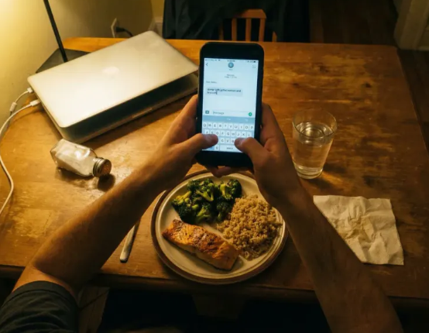

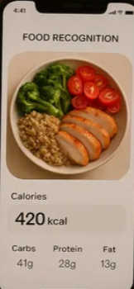


Experience NutriAI Anywhere, Anytime
Your Personal AI Dietitian is Just a Tap Away! 📱🚀
Installable PWA Web App
Works seamlessly across phone, tablet, and desktop — with offline synchronization.
16 Regional Languages
Complete UI dictionary support ensuring comfortable tracking for diverse populations.
Exportable PDF Health Summary
Share one-click diagnostic & meal report PDFs with your physician or family.
Try It Live Now on Vercel

Slide 7

Start Your Journey to Optimal Health Today! 🍏
Scan, Track, & Nourish with NutriAI.
Launch Live NutriAI Application
Thank You!

